Slide 1
Evaluating the Performance of Steering Algorithms
To produce quantitative and qualitative data

Slide 2
Introduction
What exactly will be evaluated?
This aim of this project will be to devise a set of metrics to evaluate the performance of the three following steering algorithms!
1
2
3
Blend of Traditional Steering Behaviors
Steering with Context Maps
Adapted Steering with Context Maps

Slide 3
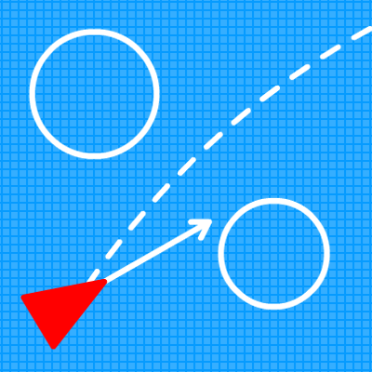
Background of Steering Behaviors
First Proposed by Craig W. Reynolds in 1999.
Set Groundwork for these algorithms as we know them today.
Such behaviors are defined as individuals and pairs such as Seek and Flee, Pursue and Evade, Obstacle Avoidance, Wander.
They act to make autonomous character move in a realistic manner, using simple forces to produce life-like behavior.

Slide 4
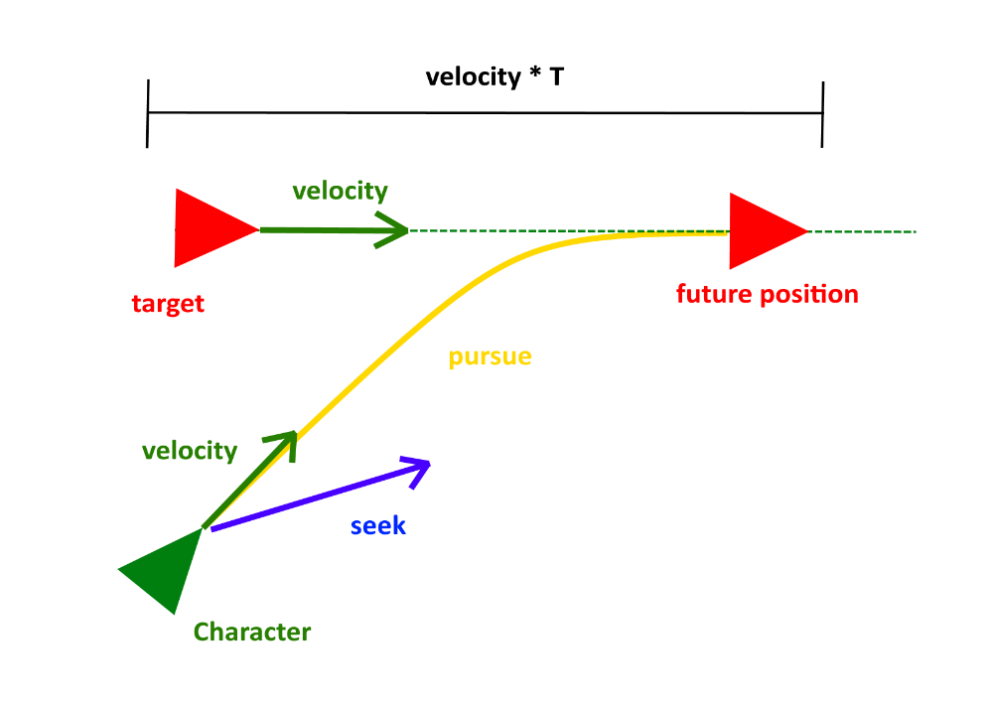
Traditional Steering Behaviour’s
Character No.1
Will operate using a blend of the Traditional Steering behaviour’s by Reynolds.
The algorithm will include Seek, Pursue and Obstacle Avoidance behaviour’s
These behaviours a not overly complex
Produce an effective behaviour similar to the behaviour produced by the context map implementation.

Slide 5
Context Maps
Character No.2 will use an implementation based on Andrew Fray’s research.
First introduced by Andrew Fray in GDC 2013.
The system writes the characters behavior into a context map.
Represented by a One Dimensional array.
The Outcome
An AI character that can make its own logical decision in regards to the path they will take.

Slide 6
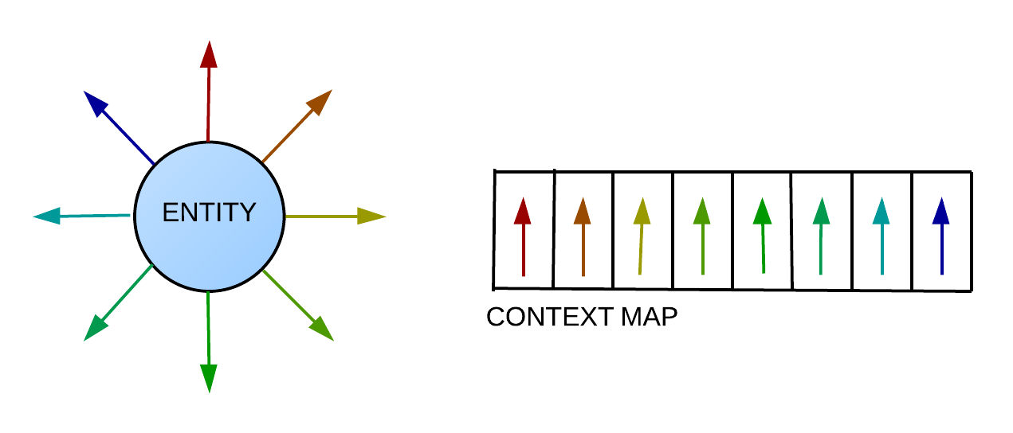
How Context Maps work
Two context Maps, One for Danger and One for Interest.
System writes the behavior’s into their corresponding Map.
These behavior’s are normalized vectors derived from a directional vector.
Before writing a value to the map, its checked against the current values
The value is entered into the map if the its stronger than the current entries.
Obstacles for Dangers, Other AI for interest.

Slide 7
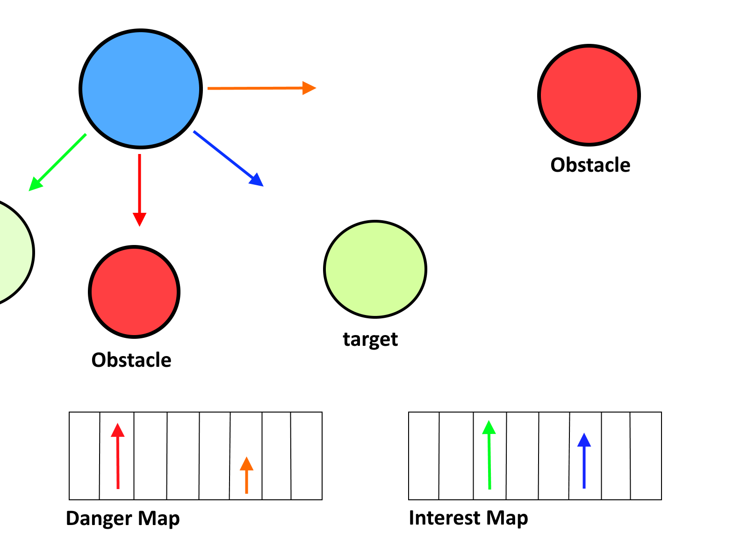
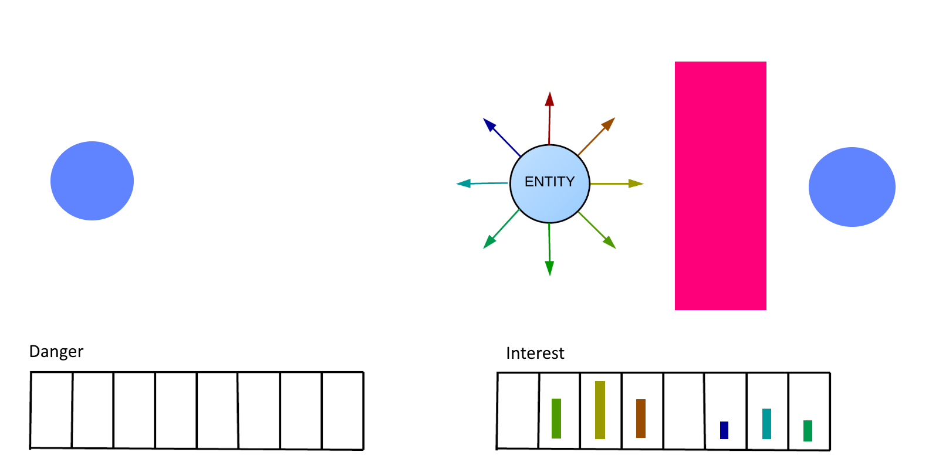
Writing Decisions to Map
Example taken from the work of Andrew Fray

Slide 8
Adapted Context Maps
Character No.3
The third character will operate using an implementation using the ideas brought forward from work by Rory O’Driscoll.
There were problems in which the dangers would override the interests under certain conditions
In solving this problem a danger threshold is used.
Including the distance of interest and danger along each of the directions.
Allows high interest values once not considered to now be considered.

Slide 9
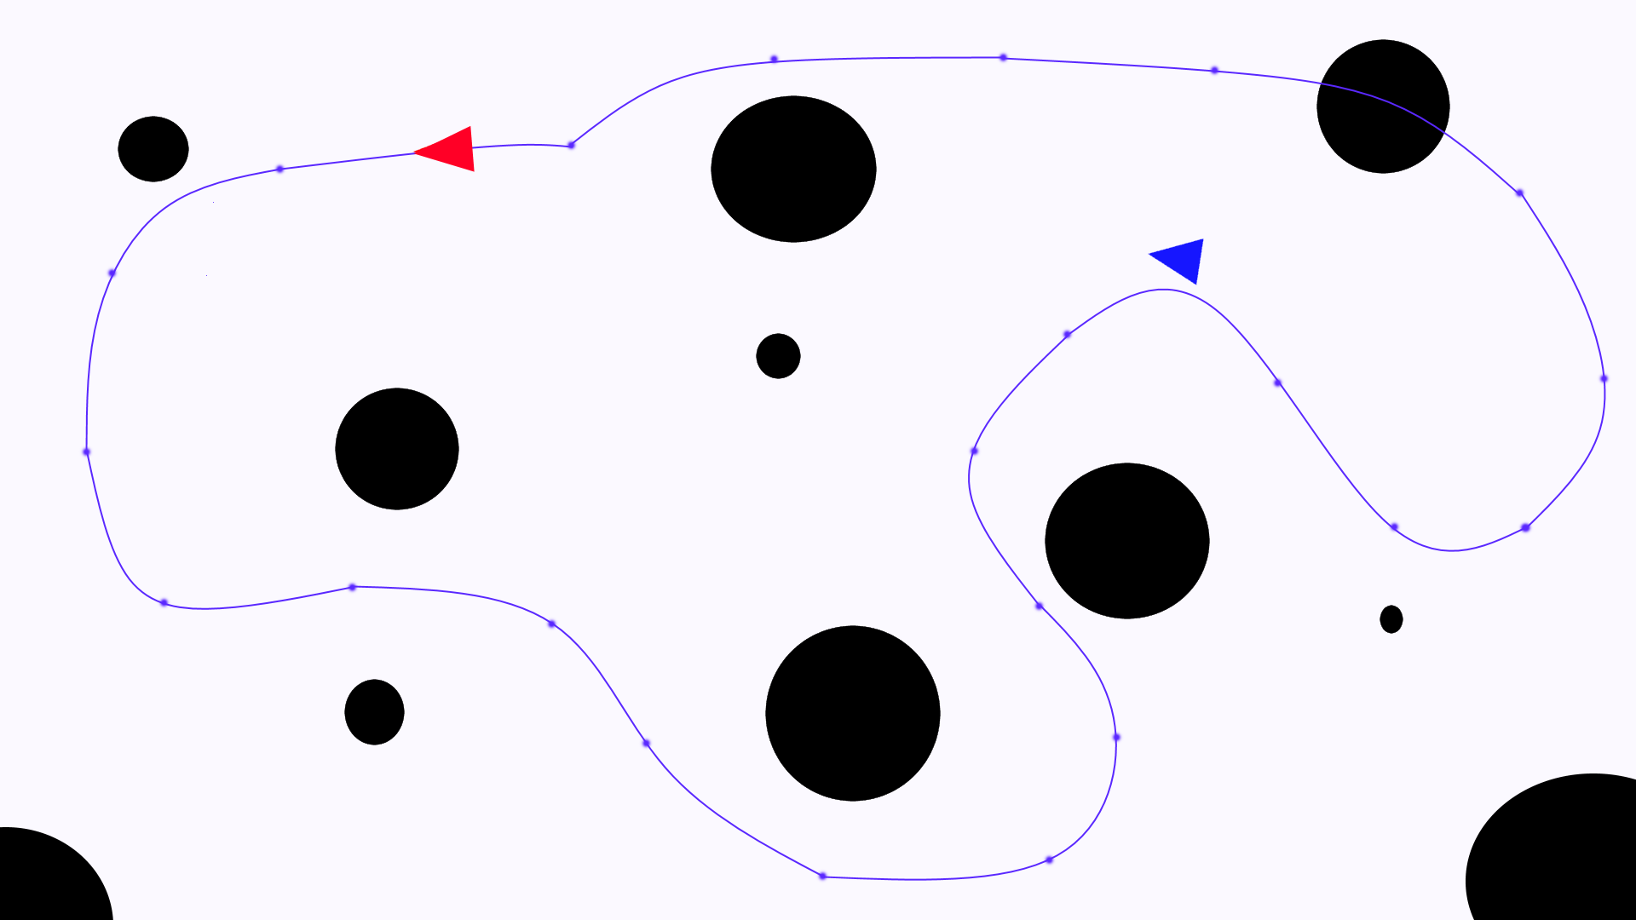
Technical Demonstration
How the Tech Demo Operates?
Each of the behavior’s will run under the same conditions.
The environment will consist of obstacles which the AI must avoid.
They will chase a scripted AI character which will follow a path of nodes around a map.
This will run until the AI is caught.

Slide 10
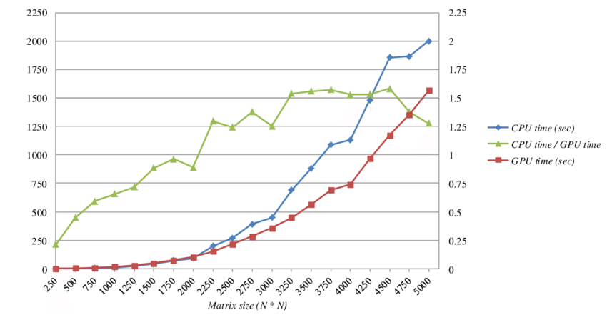
Conclusions from the Technical Demonstration
Data collected from the Technical Demonstration
AI Interception time
Average Execution Time.
Time efficiency
Path length

Slide 11
The Game
2D Top-Down Maze Game
The Objective
The objective of the game is to navigate your way through the maze and retrieve the key.
Key will unlock the next level.
Maze will contain enemy AI, operating using the Steering Behavior’s.
Along with these characters will be new characters using different behaviors eg. wander
The game will include a high-score table.
Scores will be achieved by the player completing the level as quickly as possible and collecting different collectables and tokens along the way.

Slide 12
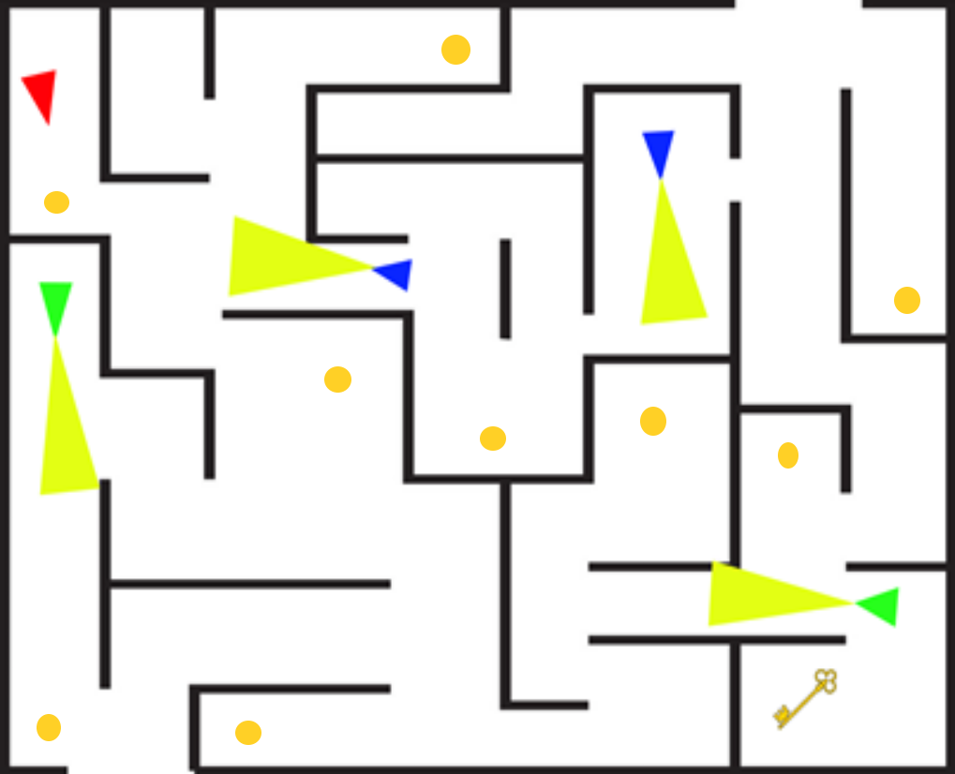
Game Screenshot

Slide 13
Conclusions from the Game
The game will be used mainly to collect qualitative data from the player.
Different questions will be answered from the player’s experience
Questions Like?
Is the game enjoyable?
What made the game enjoyable?
What’s the players favourite steering behaviour?
Do the behaviour’s work well in this specific implementation?
Are the behaviour’s fit for the purpose intended?

Slide 14
Conclusions
Different conclusions that were found through research on Frays work.
From further research of Fray’s implementation it is reported to have flaws.
Alignment can be off by using 8 directional Vectors.
Frays method is quite expensive.
Can be fixed through pre-processing context maps.

Slide 15
Conclusions continued
Different conclusions that were found through research on O’Driscoll’s work.
Fixes some issues addressed in Frays implementation such as distances.
O’Driscoll’s implementation works best by using patrol points.
Can be elaborated on to work well with path way-points.
Can also be expensive by generating new context maps each frame.
Can be fixed by interpolating between previous frame and the current frame.

Slide 16
Implemented Feature Set
Started the Traditional behavior implementation.
Two characters operating on-screen.
One Controlled by the player, Two uses Pursue and Obstacle Avoidance behavior.
Obstacles loading through YAML.
Problems Encountered
Obstacle Avoidance

Slide 17
Any Questions?
Thank You!

